Slide 1
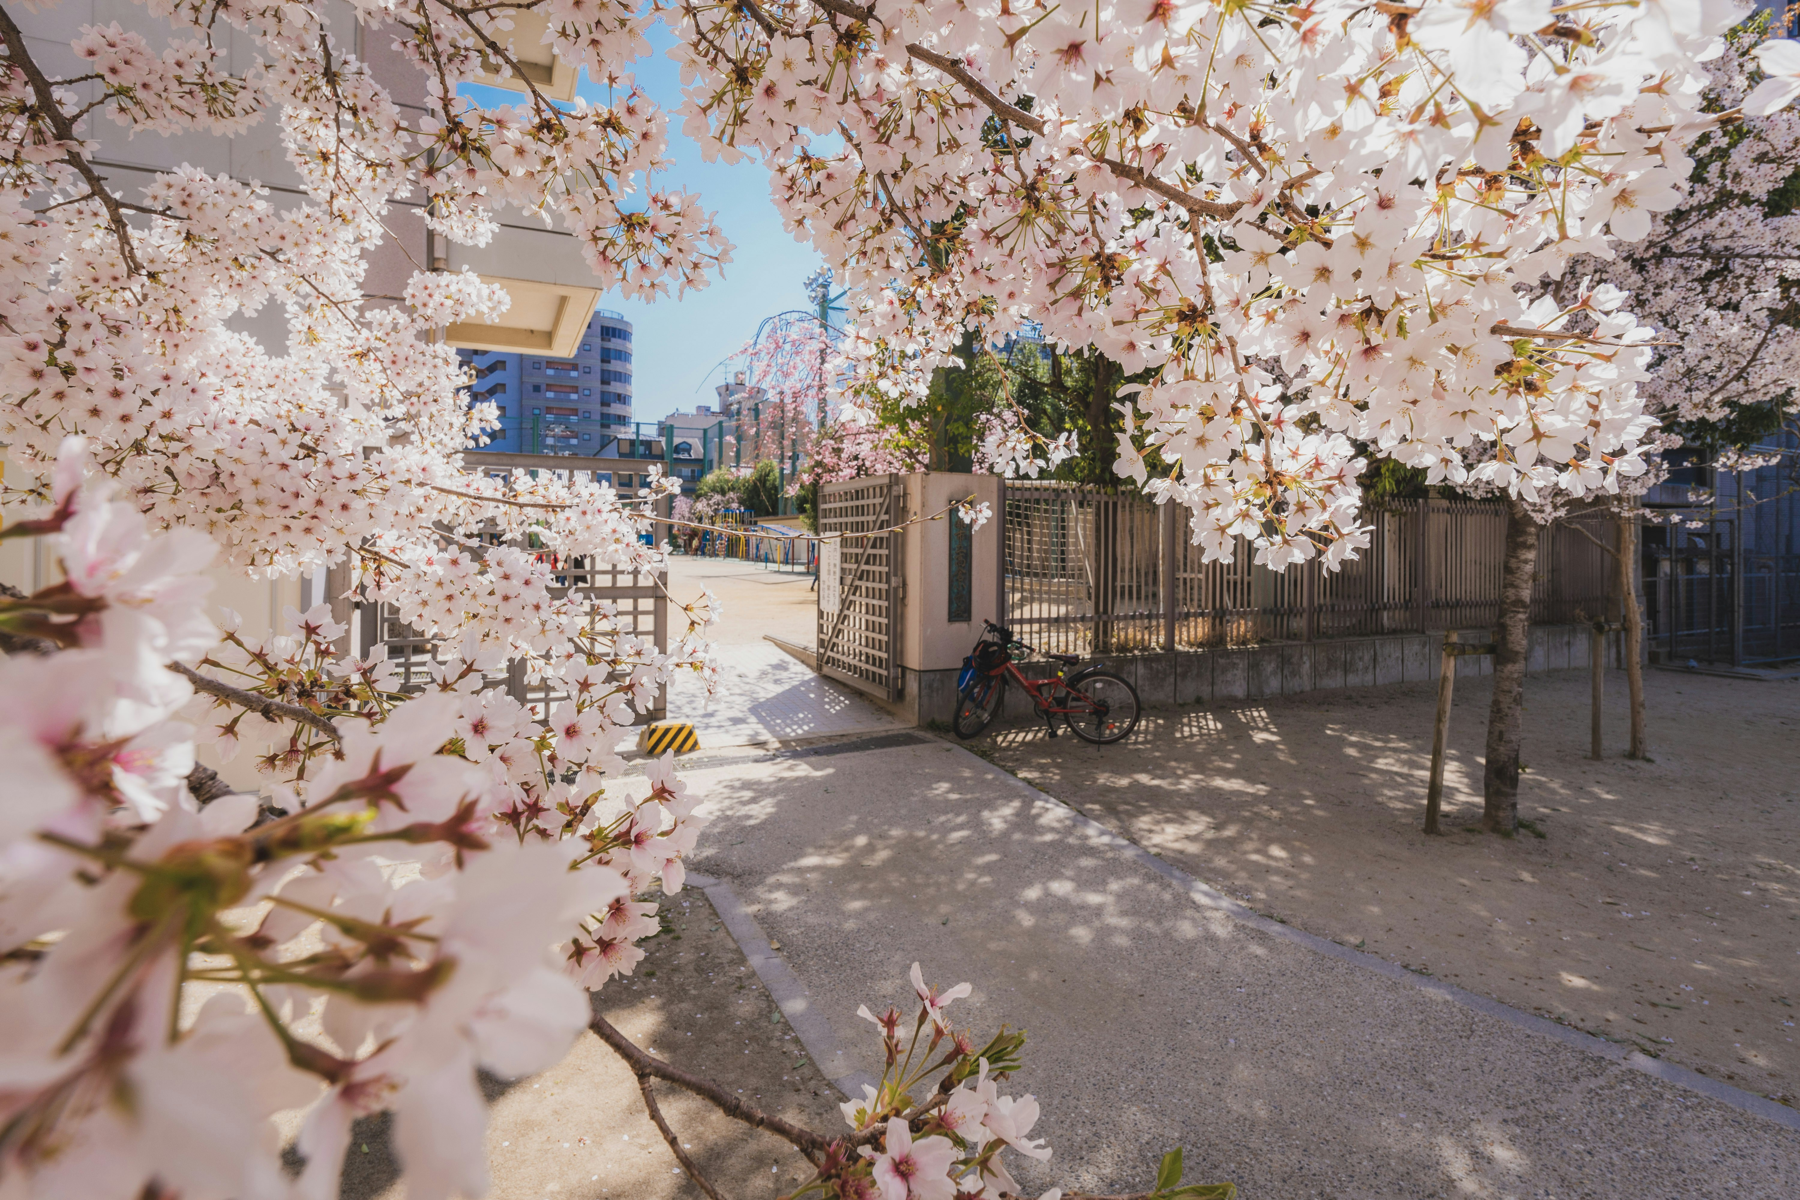
学校の物語
Notes:
https://unsplash.com/photos/a-bike-rack-with-flowers-on-it-j6RDhKDXNSw

Slide 2
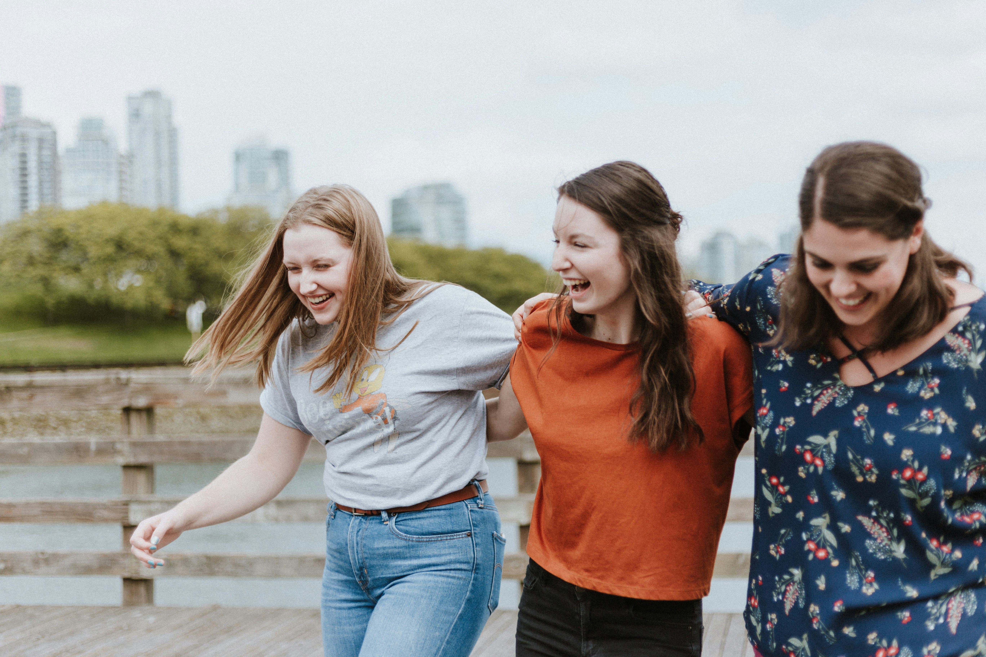
1.目標
Notes:
https://unsplash.com/photos/three-women-walking-on-brown-wooden-dock-near-high-rise-building-during-daytime-mKJUoZPy70I

Slide 3
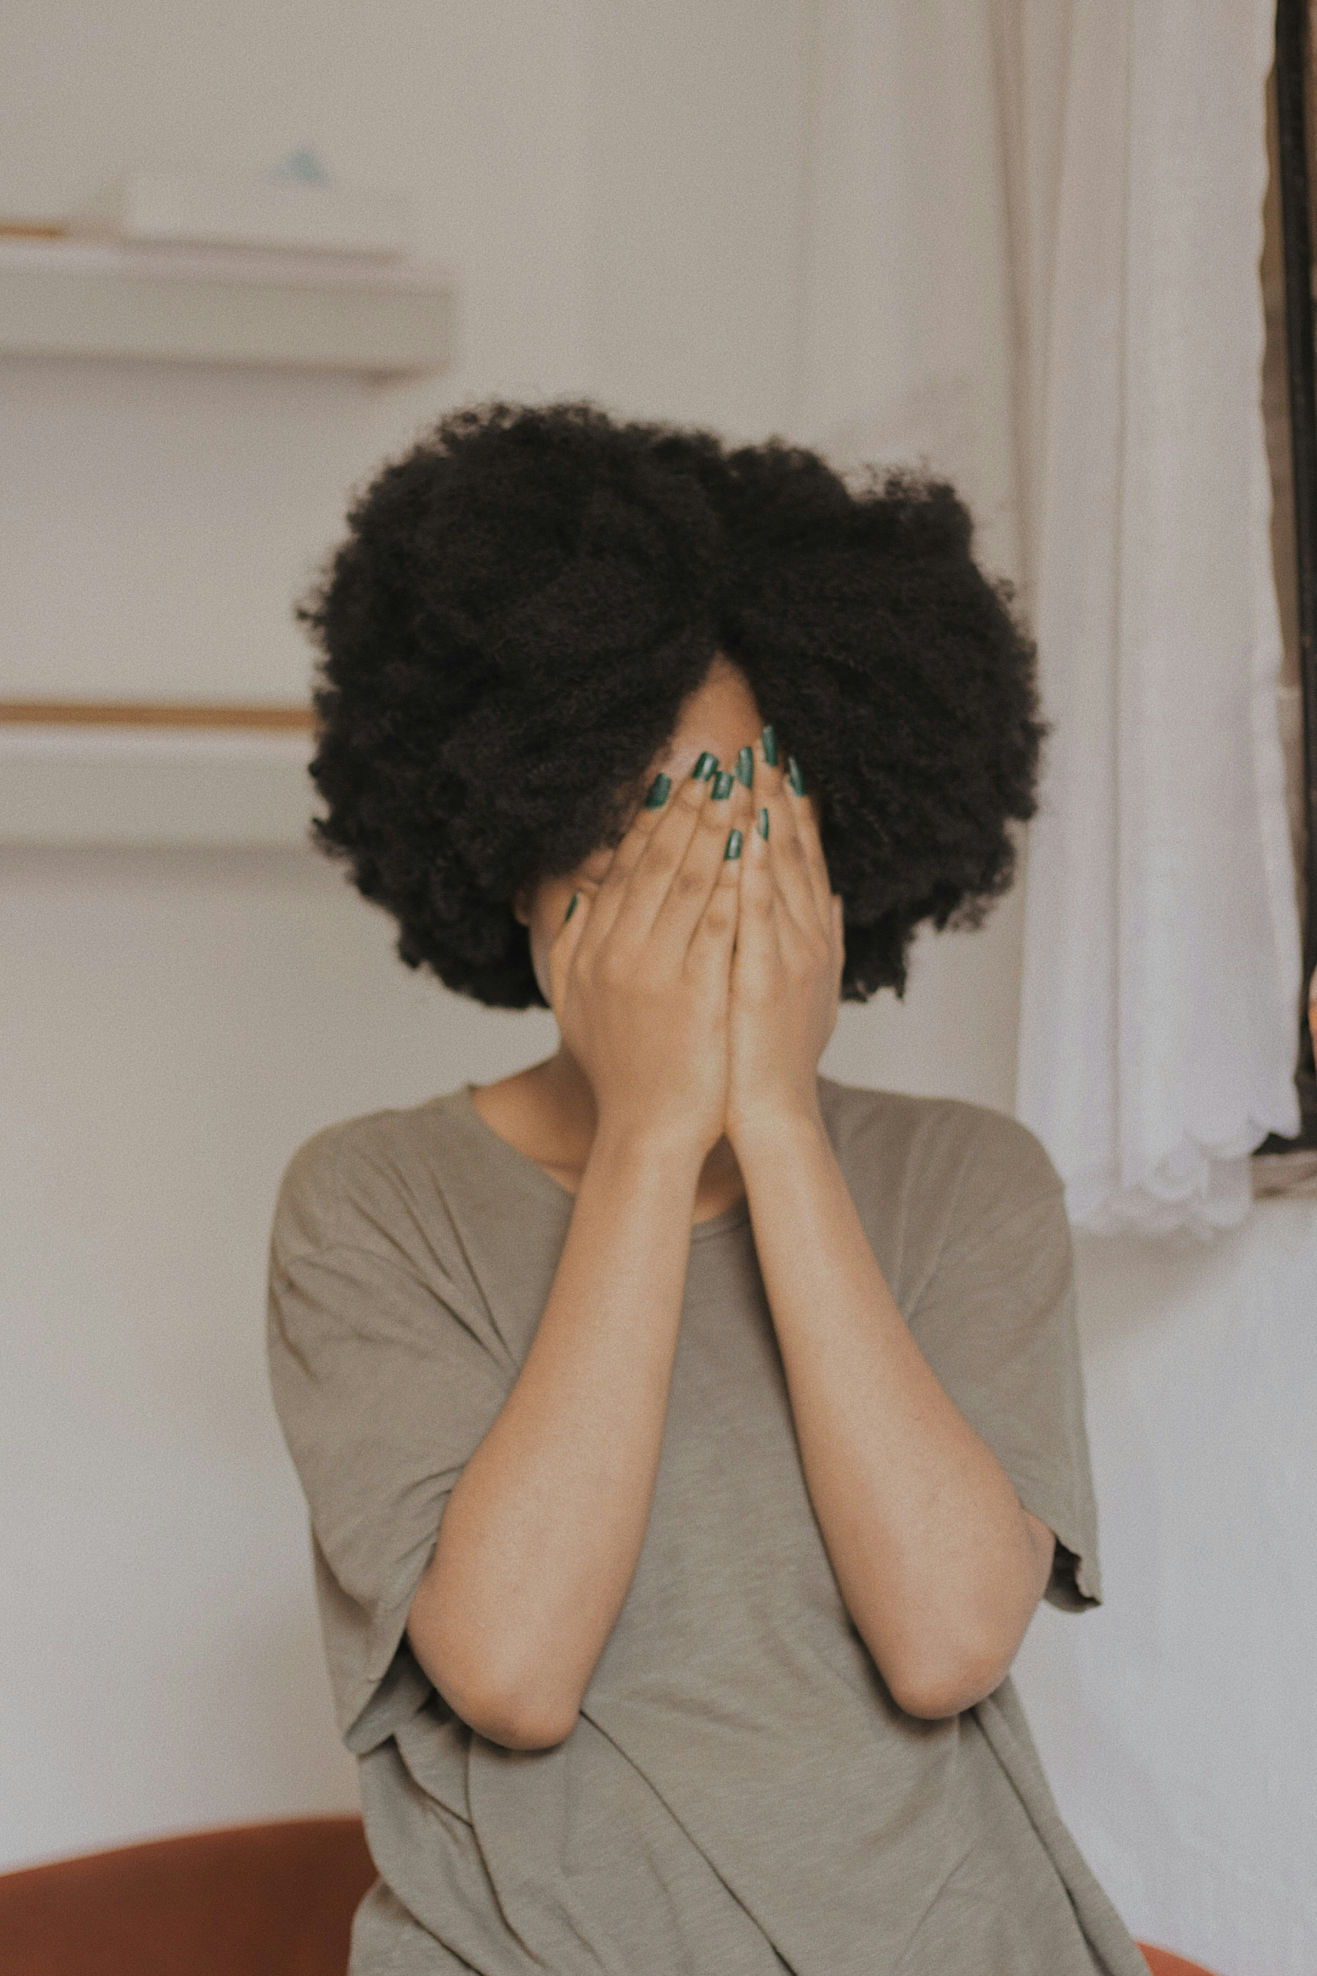
2.阻礙
Notes:
阻礙：https://unsplash.com/photos/woman-in-gray-t-shirt-covering-face-with-both-hands-XfHdVXHe94w

Slide 4

3.努力
Notes:
努力： https://unsplash.com/photos/woman-using-drawing-pad-while-sitting-in-front-of-laptop-IzmdWT2lW5Q

Slide 5
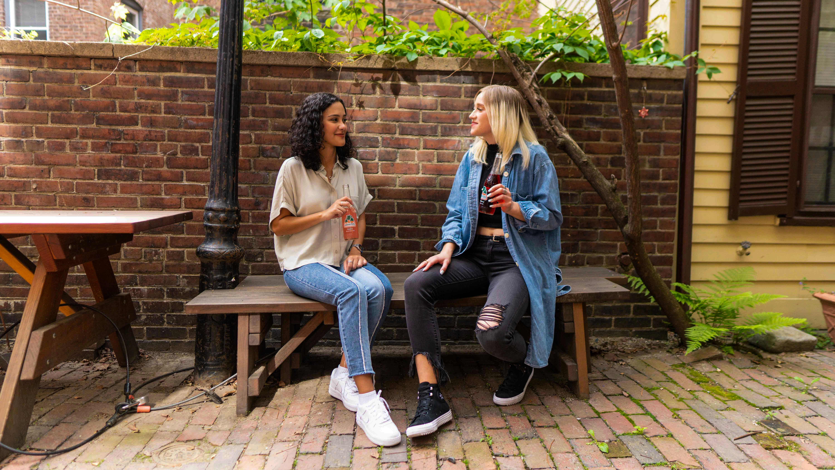
4.結果
Notes:
結果：https://unsplash.com/photos/2-women-sitting-on-brown-wooden-bench-kFEb8yigiuQ

Slide 6

5.意外
Notes:
意外：
https://unsplash.com/photos/woman-walking-taking-photo-by-people-WcdlSwAhygc

Slide 7
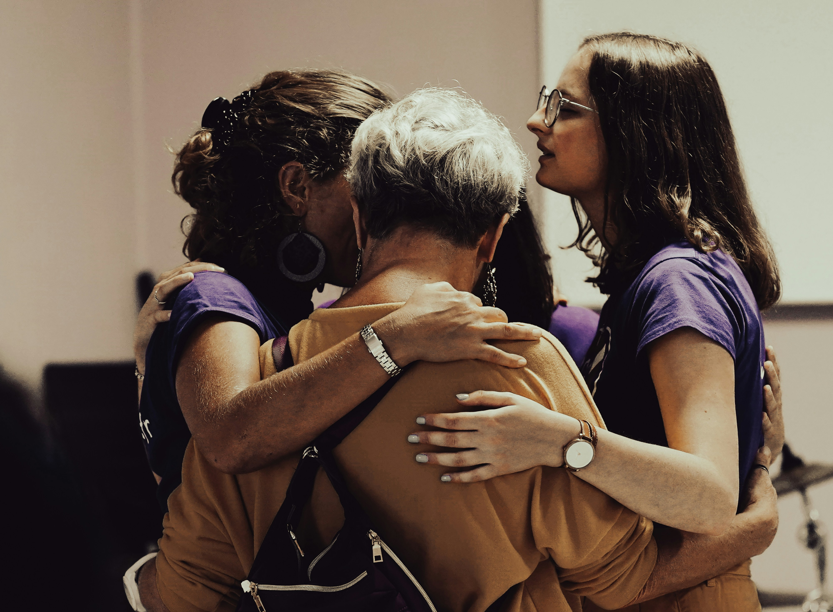
6.轉彎
Notes:
轉彎：https://unsplash.com/photos/a-man-and-woman-kissing-BkhIxji_bJE

Slide 8
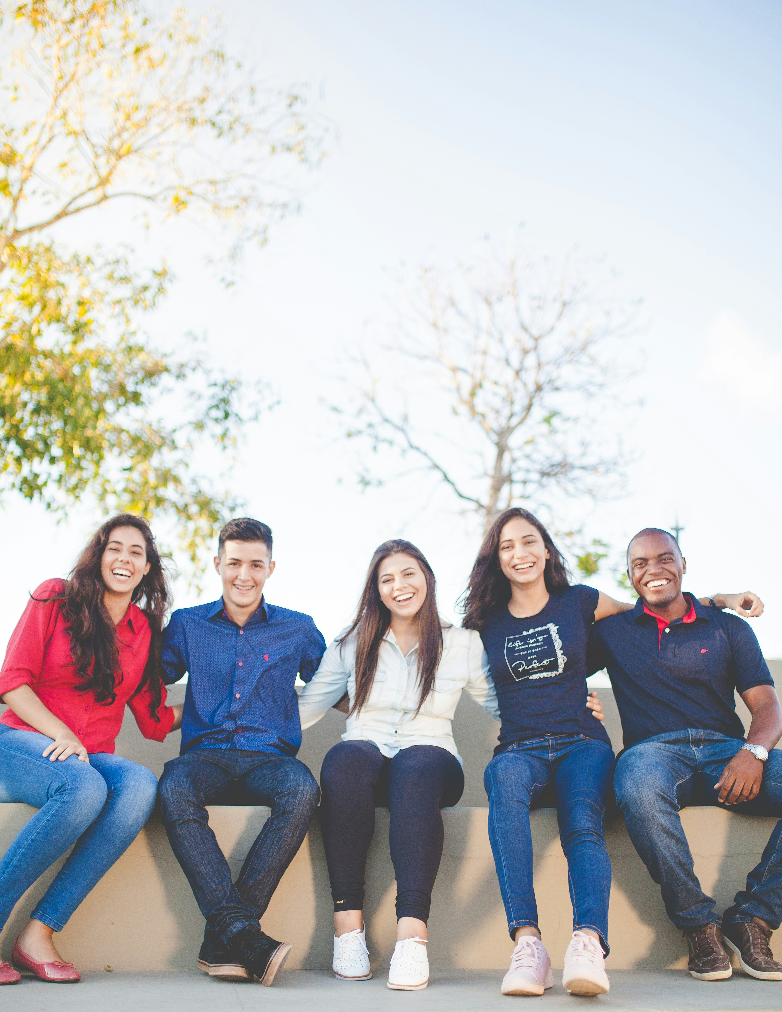
7.結局
Notes:
結局： https://unsplash.com/photos/group-of-people-sitting-on-bench-near-trees-duting-daytime-Q_Sei-TqSlc

